Slide 1
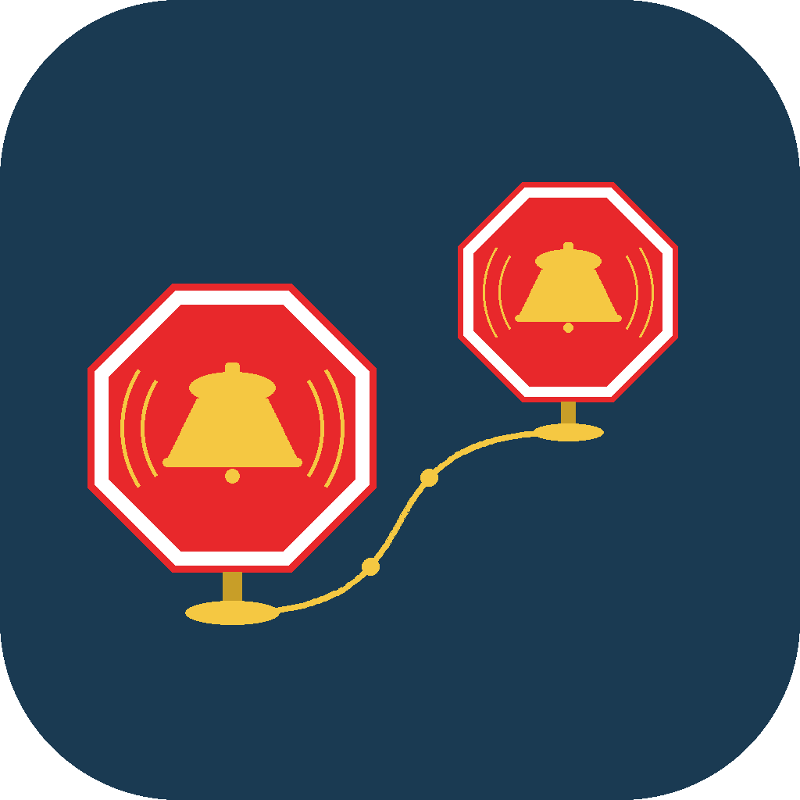
GEONAP
Location-Based Alarms for Every Commute and Journey
A geofencing platform that replaces the clock with the map — built natively for iOS, HomeKit, and CarPlay.
Product & Opportunity Overview

Slide 2
01
A Universal, Recurring Pain Point
Every transit rider, commuter, and traveler has missed a stop — or stayed anxiously awake to avoid it.

Slide 3

THE PROBLEM
Time-Based Alarms Are the Wrong Tool for Travel
Transit infrastructure isn't reliable. Broken displays, garbled PA announcements, and non-native-language signage are common failure points entirely outside a rider's control.
No two trips are the same. Traffic, delays, and transfers change arrival time — a clock alarm can't adapt.
The alternative is exhausting. Riders stay awake, watching a map, to avoid missing their stop.
GeoNap addresses this by triggering on the rider's own location, not on time or on the transit system's own — often unreliable — infrastructure.
GeoNap

Slide 4
02
Geofenced Alarms, Built Into the Places People Already Live
Native iOS app with deep platform integration — HomeKit, CarPlay, Siri, and Shortcuts.

Slide 5
HOW IT WORKS
A Simple Core Loop, Reinforced by Platform Depth
1
2
3
Set a Geofence
Background Monitoring
Trigger & Act
Pin a location or select a live transit stop; choose a distance or time-to-arrival trigger.
iOS region monitoring tracks location efficiently in the background, no app interaction required.
A system-level alarm fires — and can simultaneously message contacts or run a HomeKit automation.
GeoNap

Slide 6




DIFFERENTIATION
Depth Beyond a Simple Geofence Timer
Hybrid Trigger Model
Automated Trip Detection
Distance-based or time-to-arrival triggers, computed from live travel speed — not just a static radius.
Calendar Scanning surfaces likely trips from the user's own calendar and proposes alarms — opt-in, on-device.
Open Transit Data
Ecosystem Integration
Any public GTFS feed works out of the box — not limited to a fixed list of partnered agencies.
HomeKit, CarPlay, and Siri Shortcuts turn one alarm event into a multi-device automation trigger.
GeoNap

Slide 7

BUILT-IN VIRALITY
Every Trip Notifies the People Who Care — Not Just the User
Two-way visibility — Auto-Notify fires on departure and arrival, so a parent, partner, or friend always knows where a traveler is on their route without asking.
A natural distribution loop — every Auto-Notify message is a touchpoint with a non-user who already sees the product working.
Zero extra setup — the same trigger that wakes the traveler also updates the people around them — no separate tracking app required.
Turns a daily commute alarm into a recurring, low-friction signal to the user's network.
GeoNap

Slide 8
PRODUCT DEPTH
Feature Coverage at a Glance
Layer | Capabilities
App | Map + list views, location & transit alarm creation, custom GTFS feeds, HomeKit linking, built-in diagnostic logging
Per-Alarm | Name/notes, flexible location entry, arrival/departure trigger, adjustable radius, custom sounds, day/time scheduling, Auto-Notify
Personalization | Metric/imperial units, 3 coordinate formats, 12/24-hr clock, 13 languages, global Auto-Notify contact defaults
Every row is shipped and functional today — not roadmap.
GeoNap

Slide 9

RELIABILITY & TRUST
Engineered for Support at Scale
Privacy by architecture — calendar and location data are processed entirely on-device; nothing is uploaded without the user's action.
Built-in diagnostics — an opt-in debug log captures permission status, region events, and errors for fast support triage.
Global reach from day one — fully localized in 13 languages, spanning Western Europe, the Middle East, South Asia, and East Asia.
GeoNap

Slide 10

DEMAND SIGNALS
One Product, Five Recurring Use Cases
Daily transit commuters — a repeating alarm that resets automatically after every trip.
Bus riders — a departure alarm that solves the “don't miss the bus” problem.
Homeowners — an arrival trigger fires a HomeKit “welcome home” scene automatically.
Road-trip passengers — waypoint alarms remove the need to watch the map.
Travelers — hotel, airport, and meeting-location alarms, available in 13 languages.
GeoNap

Slide 11
TRUST & COMPLIANCE
Privacy Is a Design Constraint, Not a Policy Add-On
Calendar data is read entirely on-device and never uploaded or shared.
Calendar Scanning ships off by default and requires explicit opt-in.
Every proposed alarm requires user confirmation — nothing is created silently.
Full location-handling disclosure is one tap away in-app, at all times.

Slide 12
TECHNICAL FOUNDATION
Native Platform, Modern OS Baseline
Platform | Baseline
iPhone | iOS 26.0+
iPad | iPadOS 26.0+
Apple Watch | watchOS 26.0+ (companion features)
Connectivity model | Fully offline for core alarm functionality; network used only for transit feed downloads
A modern, narrow OS baseline keeps the codebase small and the support burden low.
GeoNap

Slide 13
03
Where This Goes From Here
The sections below are placeholders — add market sizing, roadmap, and the ask before sharing this deck externally.

Slide 14
MARKET OPPORTUNITY · ADD YOUR DATA
[ Market Size & Segments — Bob to Complete ]
Add total addressable market for daily transit riders, road-trip travelers, and business travelers in target regions.
Add relevant App Store category data (Travel / Productivity) and comparable app performance.
Add any waitlist, download, or engagement numbers once available.
Placeholder by design — no market-size figures exist in the codebase or help docs to cite accurately.
GeoNap

Slide 15
ROADMAP · ADD YOUR DATA
[ What's Next — Bob to Complete ]
Shipped: Apple Watch companion features are already part of the watchOS 26 baseline.
Add near-term roadmap items — e.g. Android, additional transit-data partnerships, or monetization plans.
Add any timeline commitments before sharing this deck externally.
GeoNap

Slide 16
THE ASK · ADD YOUR DATA
[ Funding / Partnership Ask — Bob to Complete ]
Add the specific ask — funding round and amount, distribution partnership, or transit-agency partnership.
Add use-of-funds or partnership terms once decided.
GeoNap

Slide 17
Let's Talk
Location-based alarms, built for the way people actually travel.
Contact Us
Add contact details here before sharing externally

